Slide 1
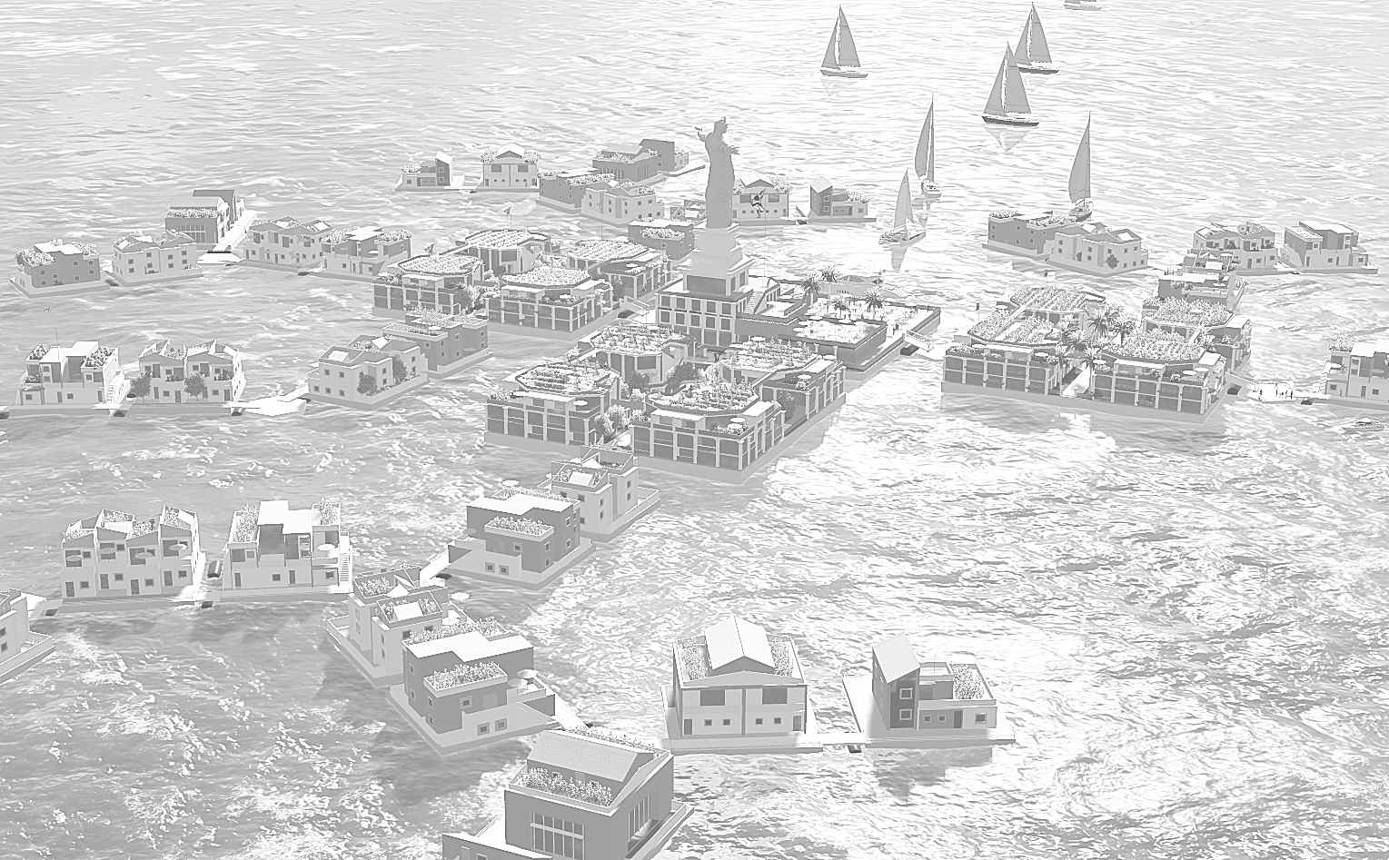
Liberstead
Registration Number #1002
Liberstead Floating City Plan is licensed using Creative Commons Attribution 4.0 International License.
Contest entry #1002

Slide 2
Liberstead Floating City Plan
This plan illustrates a city of 1000 residents in its seventh year.
Phase 1 – Four 160x160 foot concrete caissons start the city.
  Three of them have 44 condo-apartments sold as luxury residences with investment and resale value. The sales pay for the creation of the city.
  A central building contains eating, administration and medical facilities.
  Rooftop farms, integral solar power, and generous public spaces
  Emphasis on safety and security
Phase 2 – With the city core in place, the city grows by innovating a building method while at-sea.
  These units are smaller, based on 60x60 foot platforms
  Substantially lighter materials mean the units can be lifted for maintenance.
  Onsite construction (at sea) lowers the per-unit cost.
The Liberstead Plan is a realistic and cost-effective plan for a floating city that might be located in a bay, like the Gulf of Fonseca, or on the open ocean in an equatorial environment. Safety and stability are assured even with Category-5 winds and 30 foot waves.

Slide 3
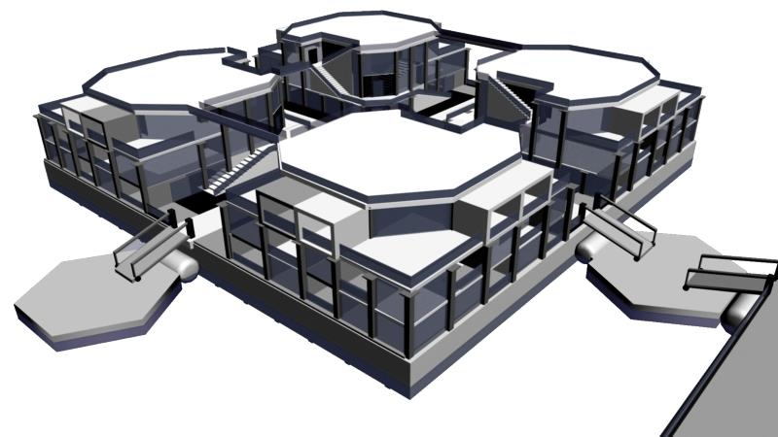
Phase 1- Urbanados - (Spanish for Swimming City)
160x160 feet (50m by 50m), concrete caisson
4 Condo buildings, 3 stories tall, 44 units total
Studio, 1, 2 and 3 bedroom units
Rooftop sustainable farming

Slide 4
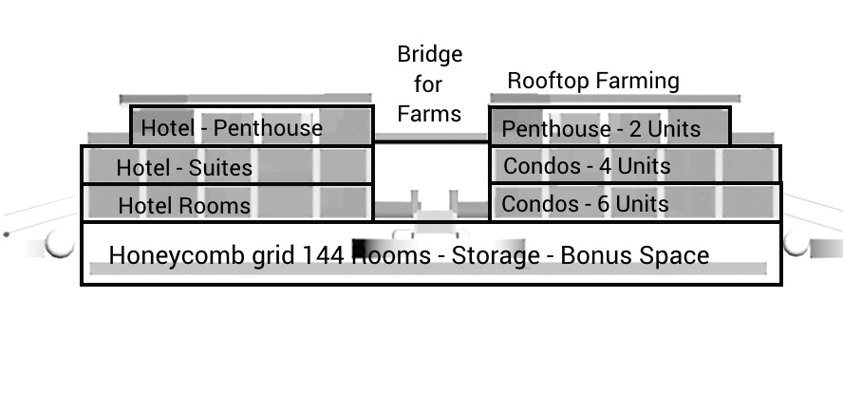
Urbanado Section View

Slide 5
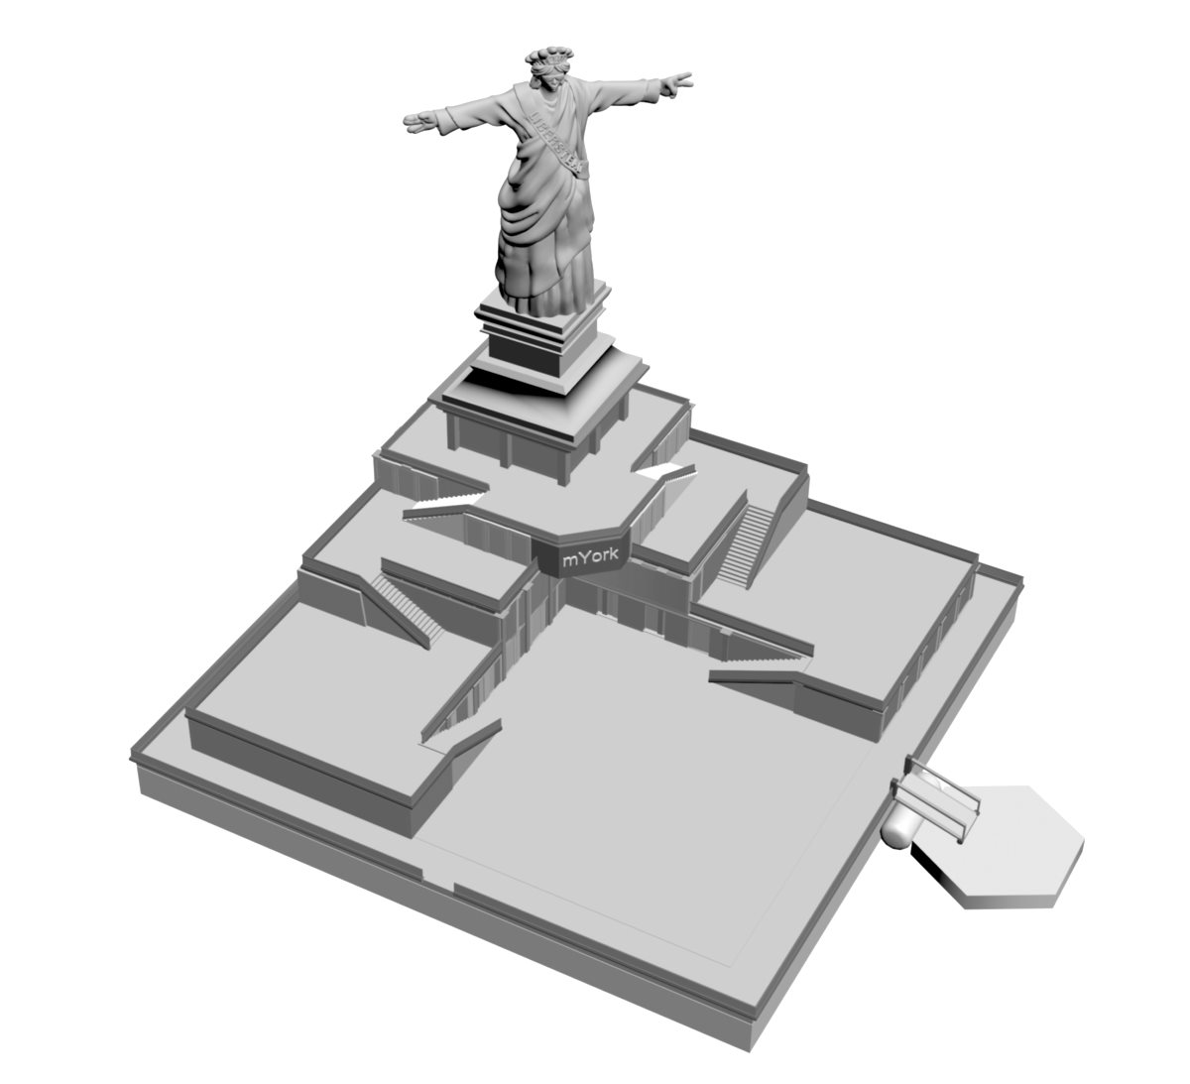
Phase 1 - mYork (mobile York)
160x160 feet
Indoor dining for 400 people
Outdoor dining on Plaza
2 Commercial Kitchens
Professional offices
Bridge
Observation Room
City center plaza
Hospital, Dentist
Liberty the Redeemer

Slide 6
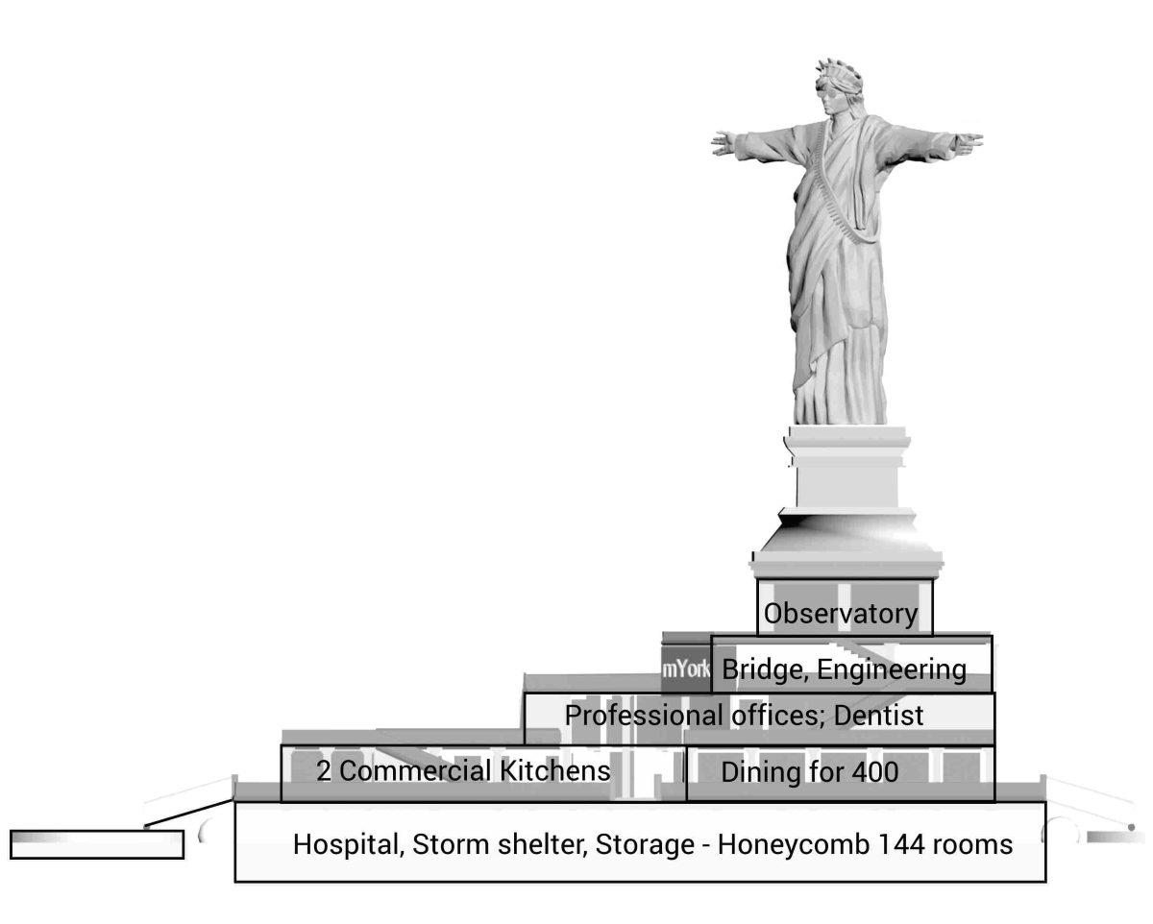
mYork Section View

Slide 7
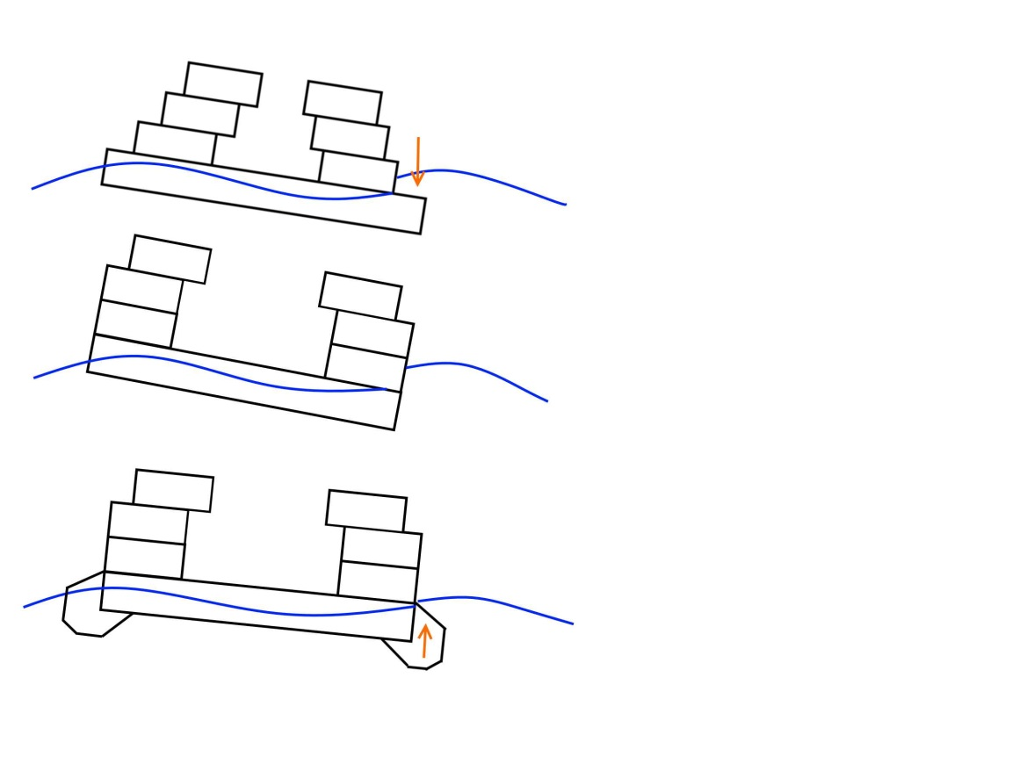
Urbanado Seakeeping
The concrete platform weighs about 5000 tons.
This mass causes the platform to lag in the waves
Waves may overtop the leading edge.
Problem:
Incoming wave overtops side.
Possible Solution 1:
Keep 1st floor flush to edge.
Possible Solution 2:
Add foam/polymer flotation
Modular Foam/Polymer edging could add 1200 tons of displacement
This would lift the concrete platform 18-inches, reducing the draft by 25% from 6-feet to 4.5-feet, increasing the freeboard from 6-feet to 7.5 feet.

Slide 8
Phase 1 Cost, Weight
Phase 1 Investment (Dollars) | Unit Sales | Ft2 | Per ft2 | Qty | Income
Penthouse 3 Bdr | 1,895,000 | 1700 | 1115 | 12 | 22,740,000
Penthouse 1 Bdr | 1,295,000 | 1200 | 1079 | 12 | 15,540,000
2nd floor 2 Bdr Suite | 1,295,000 | 1300 | 996 | 24 | 31,080,000
2nd floor 1 Bdr Suite | 995,000 | 900 | 1106 | 24 | 23,880,000
1st Floor 1 Bdr Suite | 895,000 | 800 | 1119 | 36 | 32,220,000
1st Floor Studio | 495,000 | 400 | 1238 | 36 | 17,820,000
Seed Fund or Financed |  |  |  |  | 100,000,000
Project Cost |  |  |  |  | 243,280,000
Phase 1 Expense (Dollars) | Cost |  |  | Qty | Expense
Concrete Caissons | 24,000,000 |  |  | 4 | 96,000,000
Condo Units | 220,000 |  |  | 144 | 31,680,000
mYork Office | 10,240,000 |  |  | 1 | 10,240,000
Sanitation Systems | 95,000 |  |  | 4 | 380,000
Desalinization Systems | 95,000 |  |  | 4 | 380,000
Solar + batteries | 295,000 |  |  | 4 | 1,180,000
Labor and Management | 4,400,000 | Per Yr | Years | 5 | 22,000,000
Allowance Overruns |  |  |  |  | 81,420,000
 |  |  |  |  | 243,280,000
Uses lightweight concrete low density aggregate (LWC), 110 lbs per cubic foot. Normal concrete is 145 lbs per cubic foot
Urbanado Displacement
Height | 12 | Feet Tall
Concrete Weight | 110 | Lbs/Ft3
Exterior Walls | 317 | Tons
Interior Walls | 3,174 | Tons
Slab Top and Bottom | 1,408 | Tons
Total Weight | 4,899 | Tons
Displacement | 25,600 | Square Feet
 | 818 | Tons per Foot
 | 5.99 | Draft (Feet)

Slide 9
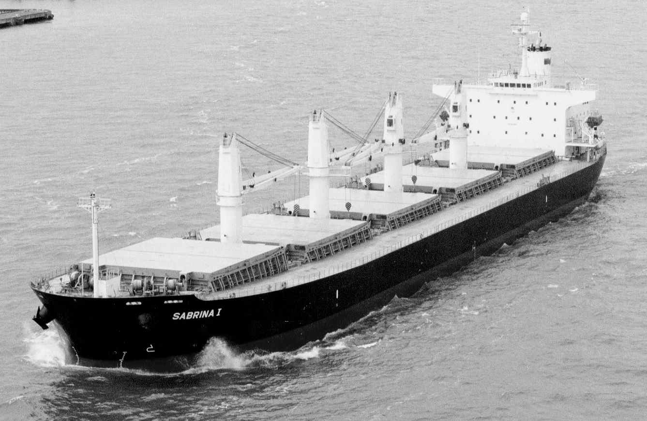
Phase 2 Concept
Phase 2 proposes:
Liberstead purchases a used Handymax size bulk carrier
Outfit the holds for 3-D building printing and building manufacture
Develop a lightweight building material possibly derived from expanded polystyrene foam (EPS) and vinyl ester resin.
With this investment, the city can manufacture at sea, and can produce 60x60 foot “Casanados”
Phase 2 Production Setup
Used Panamax Bulk Carrier | 28,000,000
Drydock and repair ship | 4,000,000
Outfit as 3d Printer | 4,000,000
Allowance/Overruns | 14,000,000
Total Production Setup Cost | 50,000,000

Slide 10
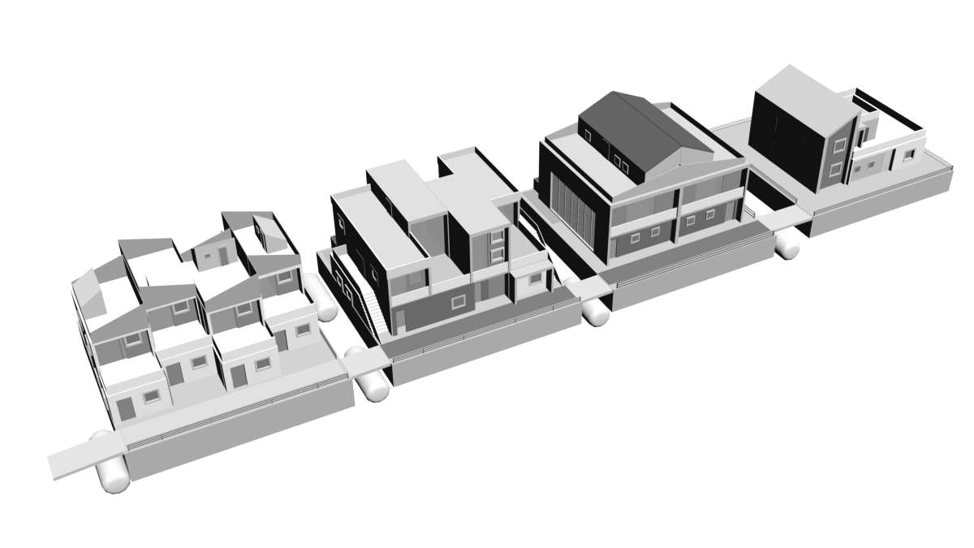
Phase 2 - Casanados (Swimming Houses)
Stylomer foam (EPS Foam + Fiberglass + Vinylester)
4-Plexes, Duplex, Single House
3-D Printed at sea (on site)
60x60 foot platform

Slide 11
Phase 2 – Casanado Cost, Weight
Phase 2 Casanado cost | Quantity |  | Per |  | Cost (Dollars) |  | Lbs | Weight
EPS/Wall Fill | 20160 | Ft3 | 1.42 | ft3 | 28,627 |  | 1.20 | 24,192
Exterior Coating | 14400 | Ft2 | 108 | Gal | 13,392 |  | 1.00 | 14,400
Structure Framing | 14400 | Ft | 3.62 | Lin foot | 52,128 |  | 0.50 | 7,200
Windows | 44 |  | 400 | Per | 17,600 |  | 20 | 880
Fixtures | 4 |  | 2000 | Total | 8,000 |  | 20 | 80
Instant hot water | 8 |  | 500 | per | 4,000 |  | 20 | 160
Desalinization | 1 |  | 8000 | per | 8,000 |  | 400 | 400
Waste Treatment | 1 |  | 8000 | per | 8,000 |  | 1,200 | 1,200
Solar Power + Battery | 1 |  | 4000 | per | 4,000 |  | 2,400 | 2,400
Gyroscope | 1 |  | 40000 | per | 40,000 |  | 1,200 | 1,200
Labor/Management | 16 |  | 500 | per day | 8,000 |  |  | -
Allowance/Overrruns | 1 |  |  |  | 28,253 |  |  | -
Cost to manufacture a Casanado |  |  |  |  | $ 220,000 |  | Weight | 52,112
 |  |  |  |  |  |  | Draft-Ft | 0.23
Estimated Phase 2 Housing Prices | Sales Price | Ft2 | Per ft2 | Qty | Total
2 Bdrm Townhouse in 4-Plex | 59,500 | 1120 | 53 | 4 | 238,000
2 Bdrm Flat in 4-Plex | 59,500 | 1000 | 60 | 4 | 238,000
3 Brdm Duplex | 114,500 | 1800 | 64 | 2 | 229,000
Detached House | 229,500 | 2100 | 109 | 1 | 229,500
At $53 per square foot, casanados make Seasteading affordable

Slide 12
No Connections
Each Platform contains
  Solar Cells and Batteries
  or Wave Power Generation
  Water Desalinization
  Sewage processing
Centralized services
  Commercial Laundry
  Food Production
  Garbage Composting
  Trash Incinerator
  Satellite Internet
Each Unit Uses
  Low Flow Toilets
  Instant Hot Water
  Natural Air Cooling
  LED Lights
  LED Walls (video)
Proposed HOA
  $100/mo maint
  $100/mo medical
  $250/mo food
  Voluntary HOA Fee

Slide 13
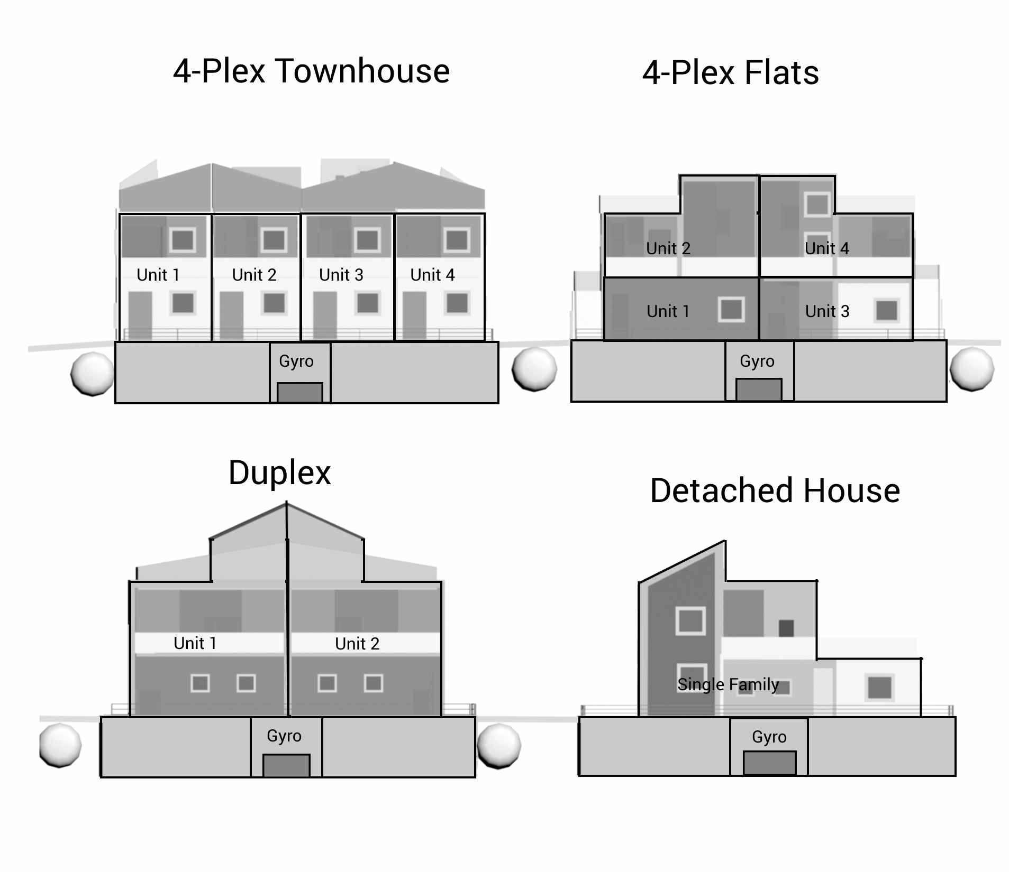
Casanado Section View

Slide 14
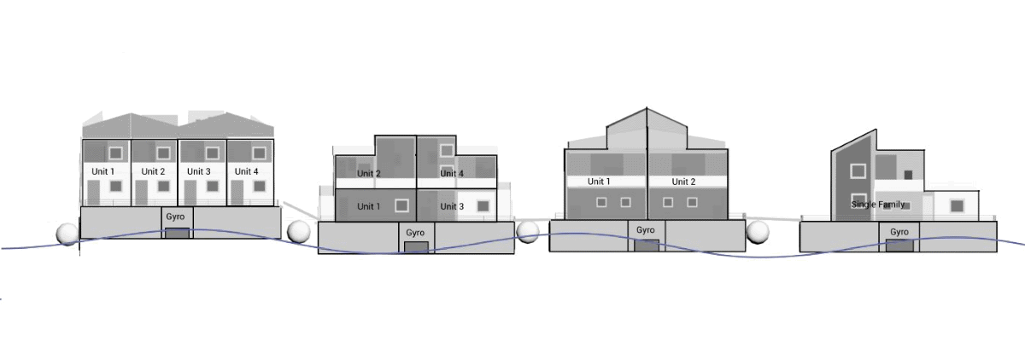
Casanado Seakeeping
Casanados are light – draft one-foot, freeboard 7-foot
Marine gyros can easily steady the light structures
Seakeeping – 25mph wind, 5-foot waves, 10 waves per minute
Vertical rise 3-feet, angular motion zero (gyro dampened)

Slide 15
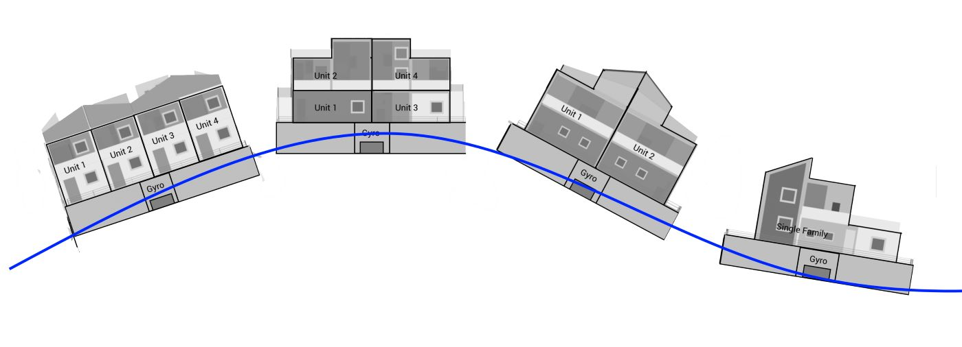
Casanados in Storms
In heavy waves, the gyros spin down.
Casanados follow the waves.
50mph wind on open ocean (1000 mile fetch)
30 foot waves, 5 waves/min
7-feet of freeboard adds reserve buoyancy
Overall light design “Like a boat” prevent upset

Slide 16
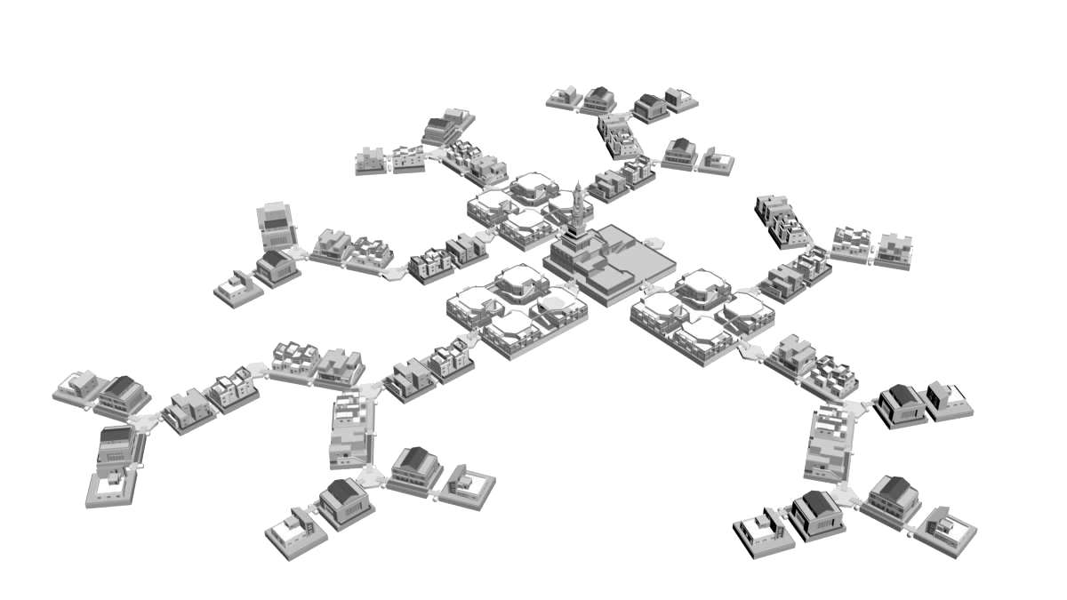
City Plan
Heavy platforms at city core
Outer units dampen waves
Bulk carrier prints casanados
Fishing, farming
Eco—Sustainable
Affordable Freedom

Slide 17
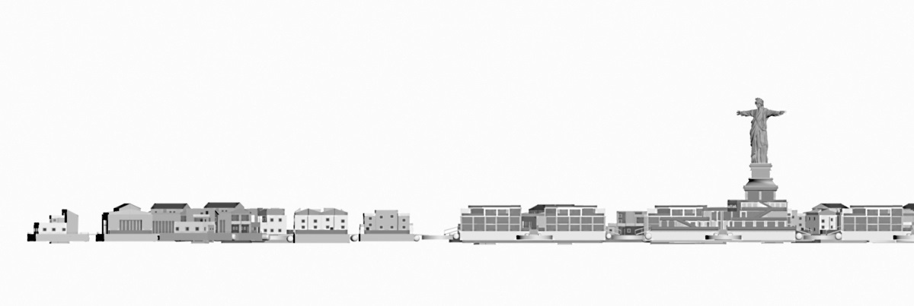
Liberstead
Thank you for learning about Liberstead
Now, sit back and enjoy the pictures
Liberstead Overall Section View

Slide 18
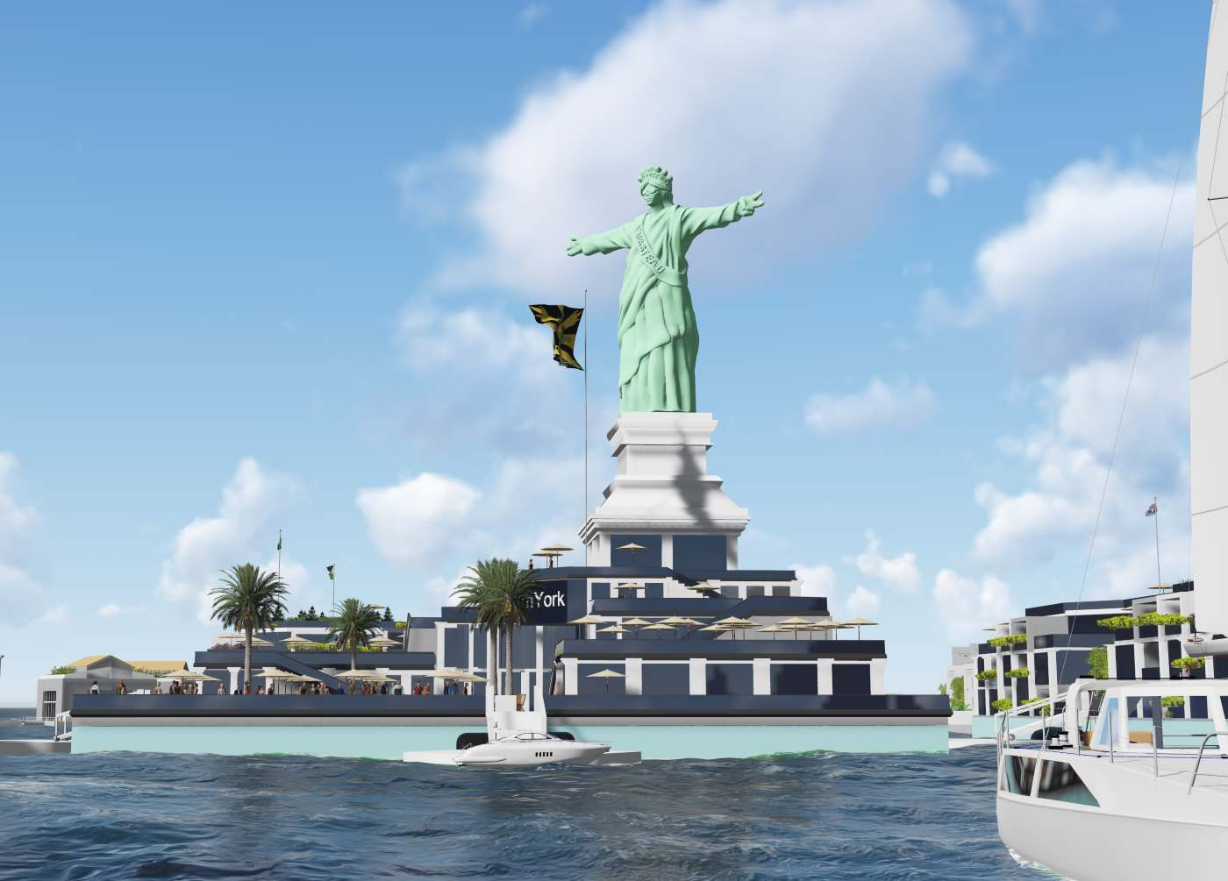

Slide 19
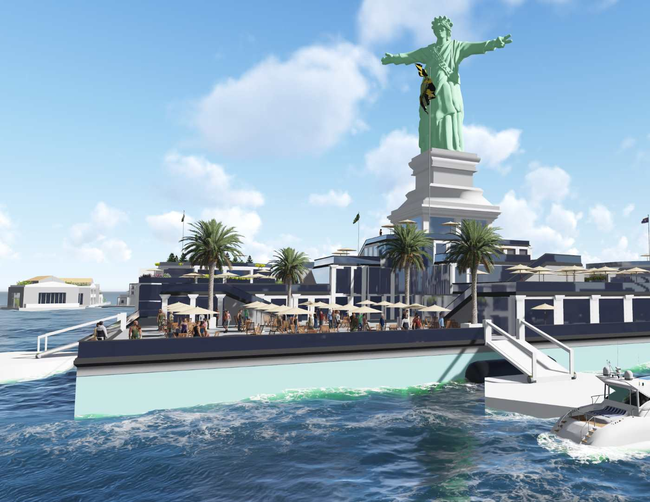

Slide 20
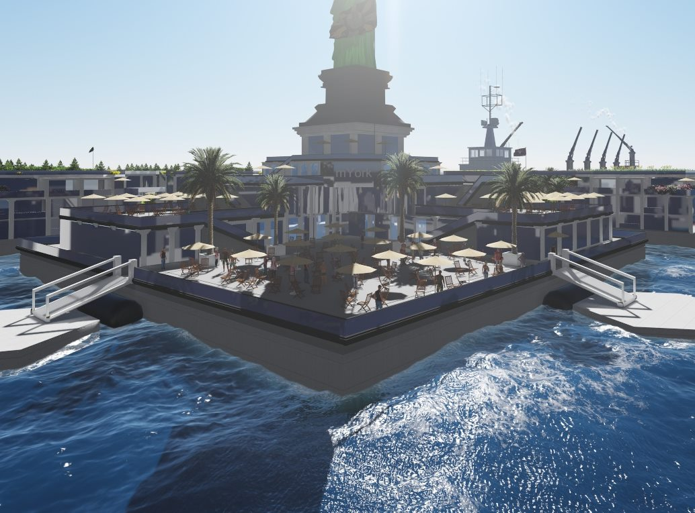

Slide 21
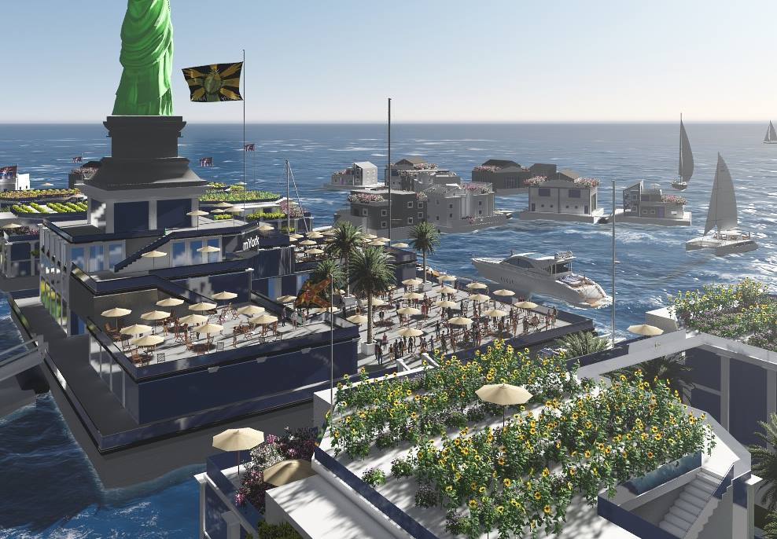

Slide 22
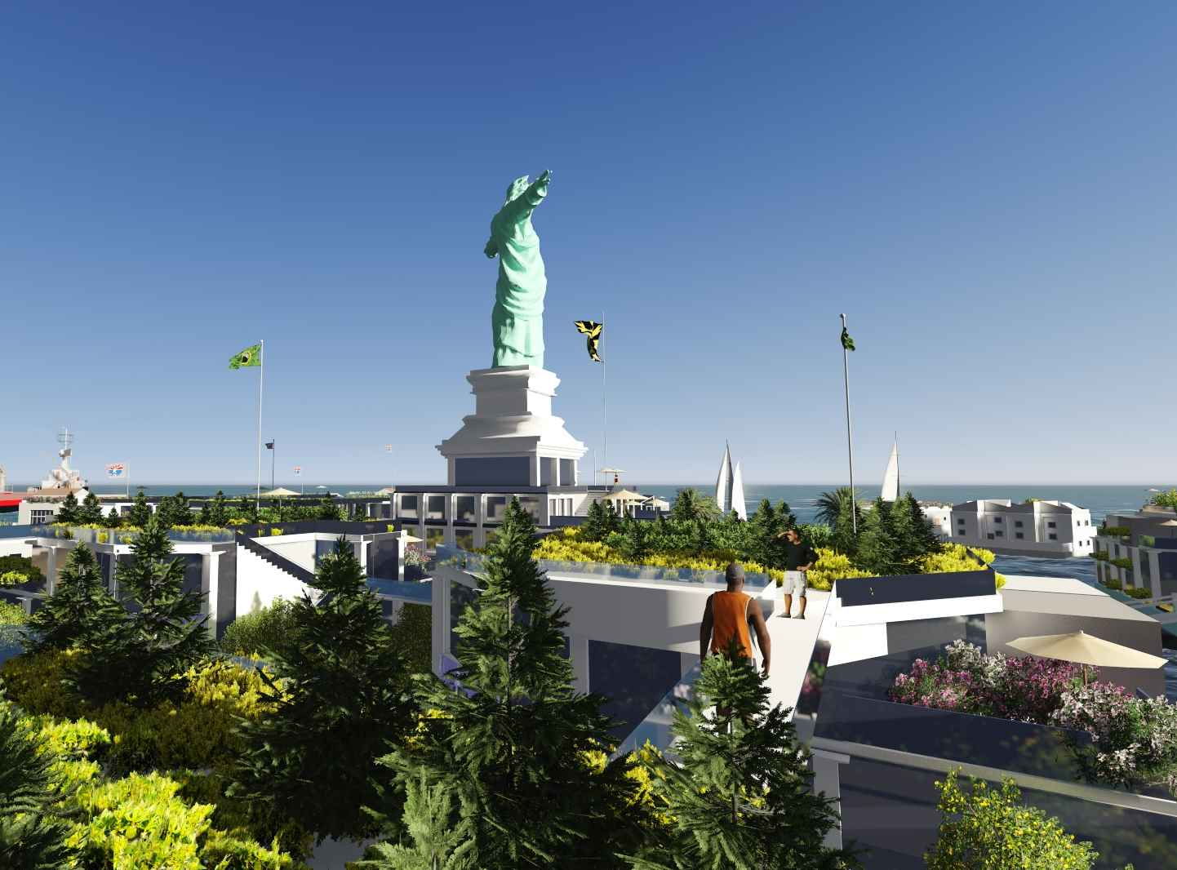

Slide 23
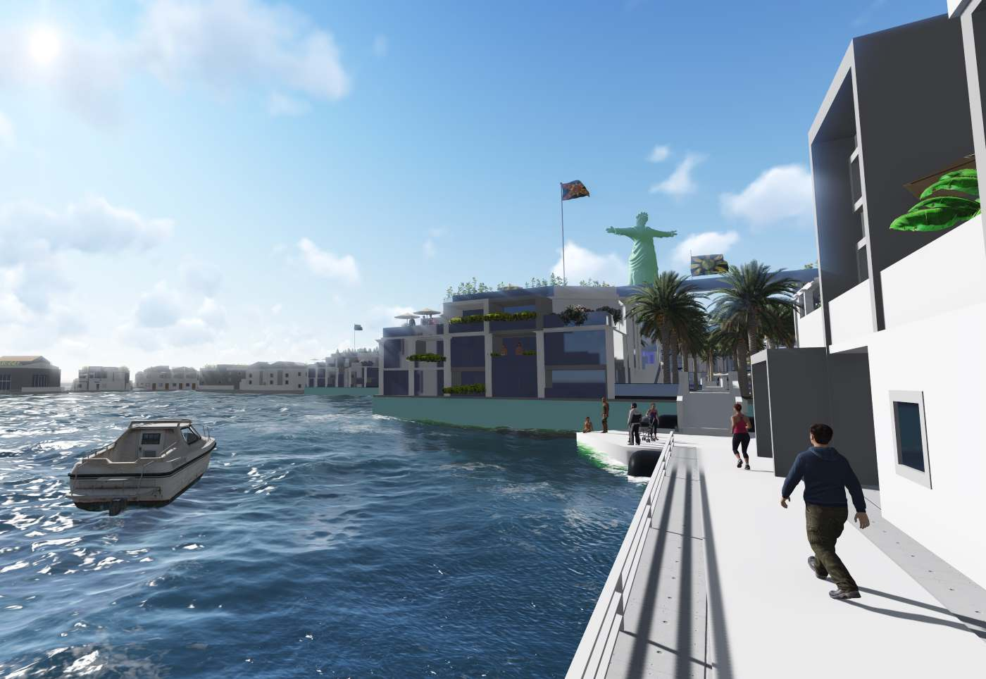

Slide 24
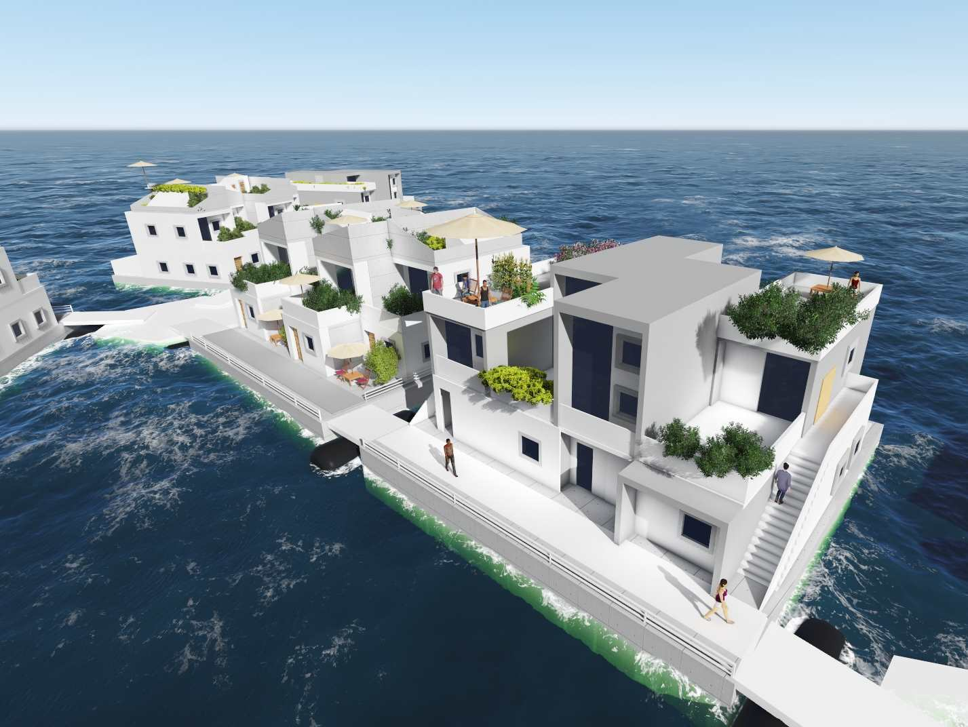

Slide 25
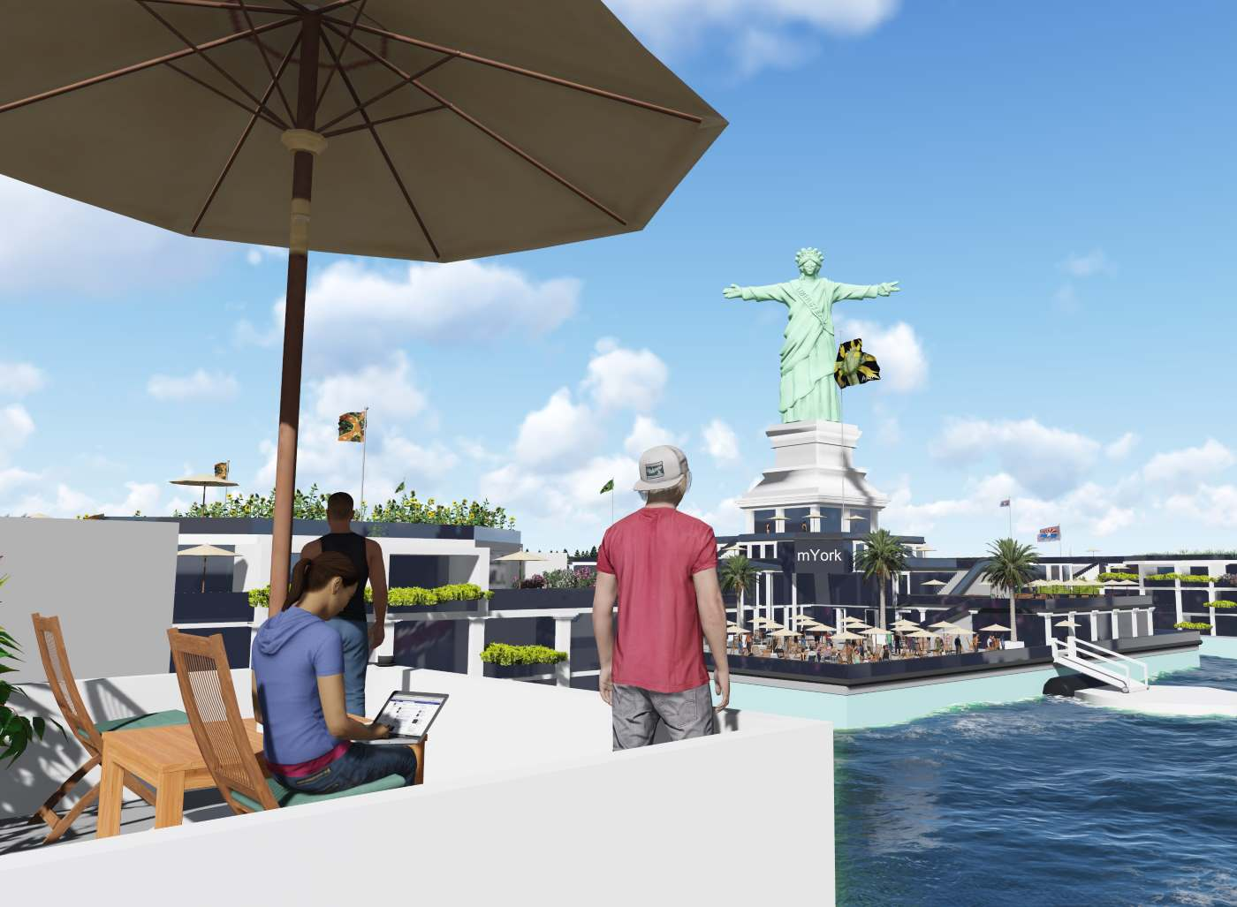

Slide 26
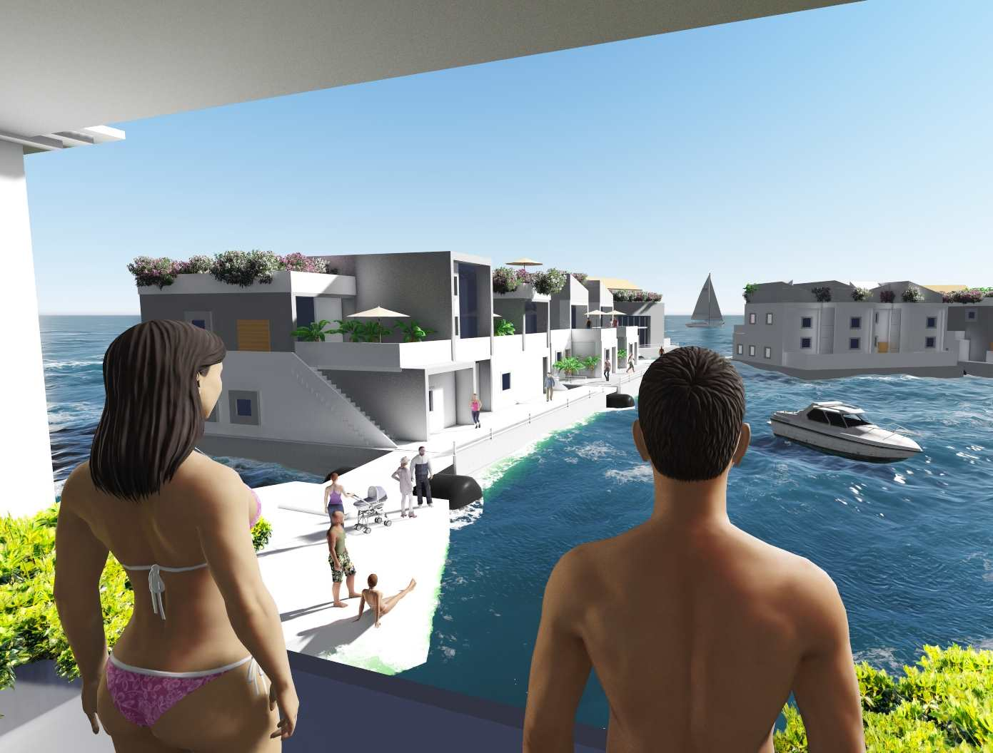

Slide 27
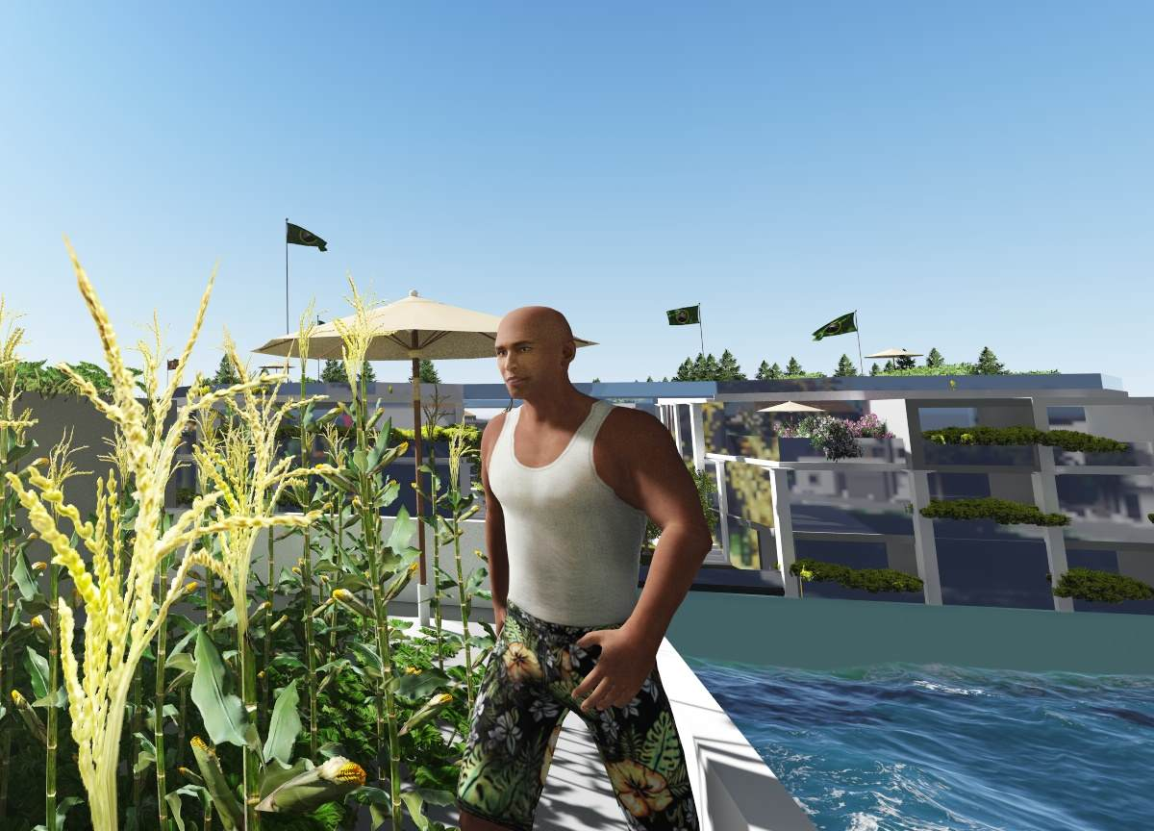

Slide 28
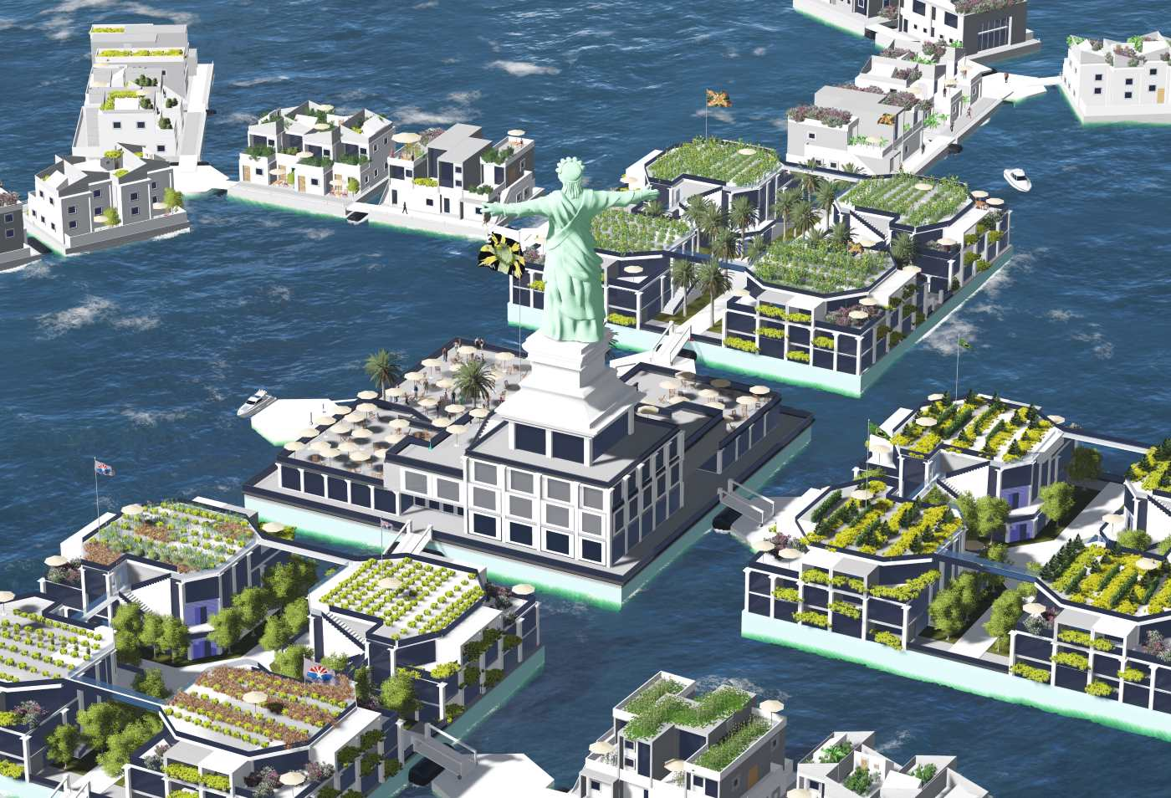

Slide 29
